Slide 1
Spark Data Analysis Project
Based on “Game of Thrones”
汇报人：贾博凯 何宏栋 李明锐 王博瑛 陈致宁
导 师：张美慧

Slide 2
目录
1
Overview
Basic information
2
Project Content
What we’ve done
3
CONTENTS
Visualization
A clearer way
4
Conclusion
What we get

Slide 3
01
Overview
Basic Information

Slide 4
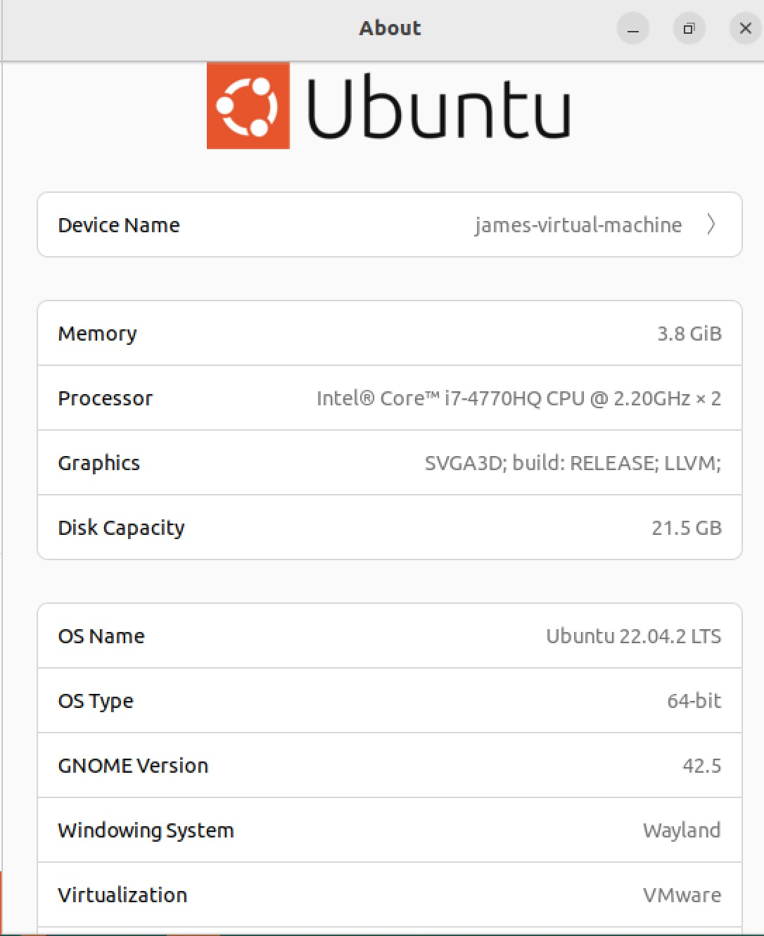
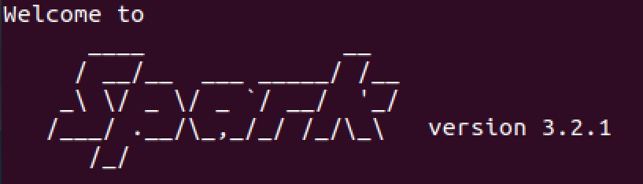
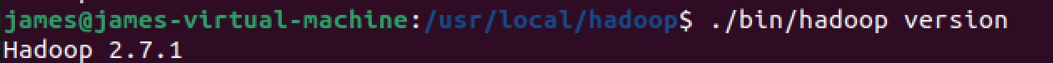
Environment Configuration
Ubuntu22.04
JDK8
Hadoop 2.7.1
Spark 3.2.1
Scala 2.12.15
Python 3.8
Pandas 1.3.5 matplotlib 3.2.2 word cloud 1.5.0） seaborn 0.11.2

Slide 5
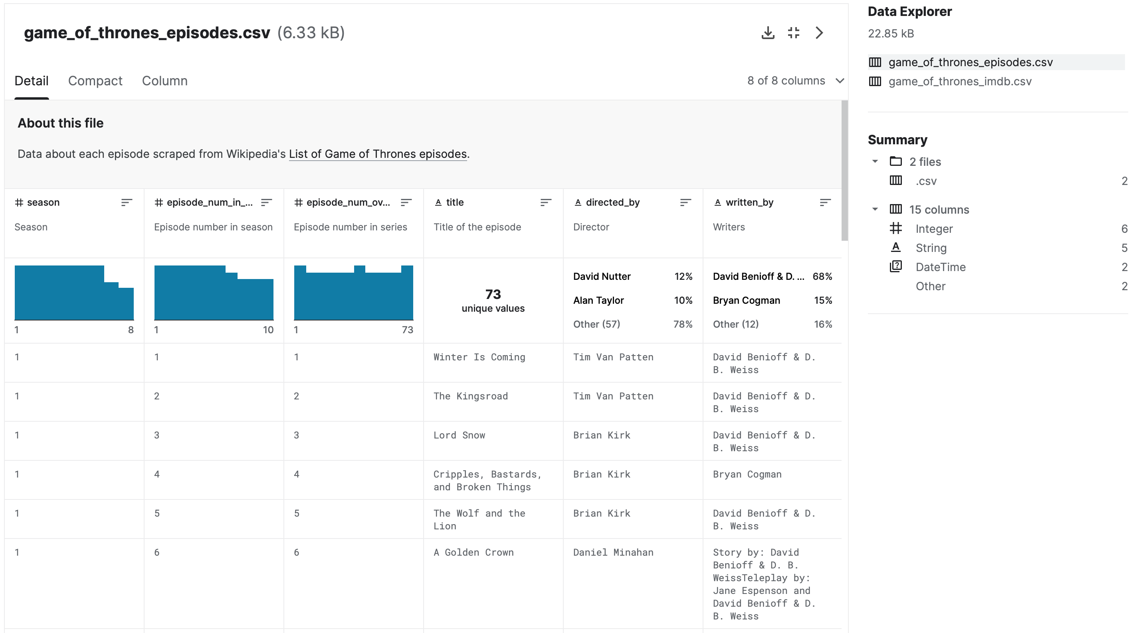
Dataset Overview
Game of Thrones
This is the dataset of our project.
There are two .csv files, including data about episode, ratings and episode summary description, respectively.
https://www.kaggle.com/datasets/bcruise/game-of-thrones-episodes

Slide 6
Dataset Overview
Game_of_thrones_episodes.csv
This file have eight columns.
1.season (shows the seasons)
2.episode_num_in_season (shows the episodes of seasons) 3.episode_num_overall (shows the episodes of the series)
4.title (shows the title of the series)
5.directed_by (director of episodes)
6.written_by (series writers)
7.original_air_date (scheduled airing time)
8.us_viewers (viewers in the US)

Slide 7
Dataset Overview
The second table contains the following fields:
1.Season (which seasons)
2.Episode_num (which episodes in which seasons)
3.Title (the title of the show)
4.Original_air_date (the scheduled airing time)
5.Imdb_rating (the average IMDb rating, IMDb is an online database of film actors, movies, TV shows, TV stars and film productions)
6.total_votes (the number of votes cast)
7.Desc (main content description of the episode).

Slide 8
02
Project Content
What we’ve done

Slide 9
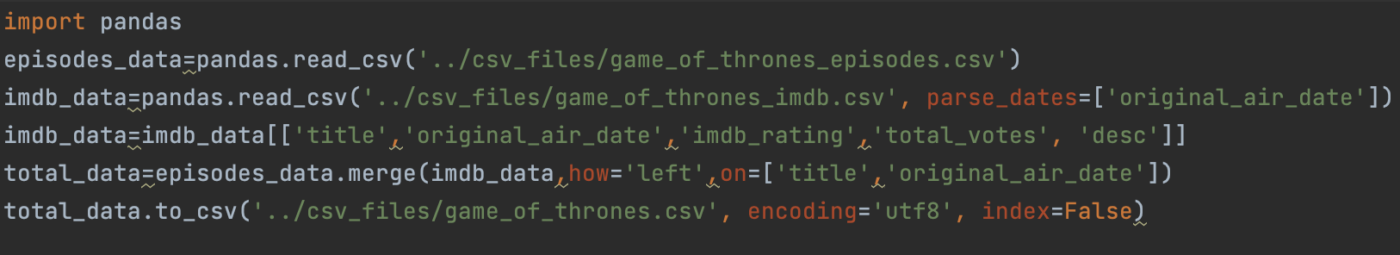
Project Content:Preprocessing
Firstly we read the files and use parse_dates parameter is to format data type.We notice that there are same columns in two files. So we decide to merge them into one file based on title and publish date. Then we ouput the newly merged file.

Slide 10
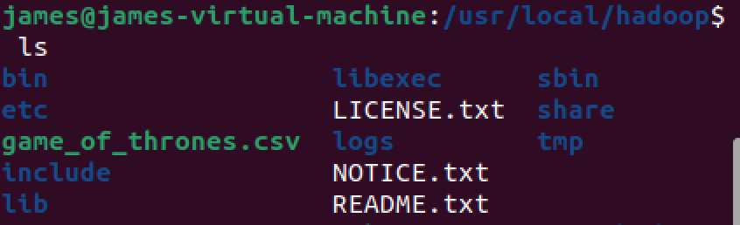
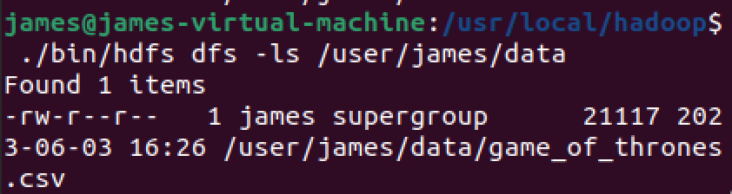
Project Content:HDFS
We put the merged file into hadoop directory, start the hdfs (./sbin/start-dfs.sh) and put the file into hdfs(./bin/hdfs dfs -put game_of_thrones.csv /user/james/data).
The second pic shows that it has been uploaded successfully.

Slide 11
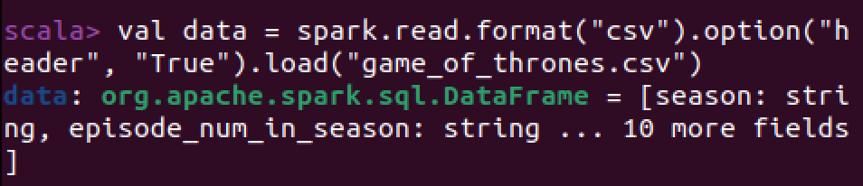
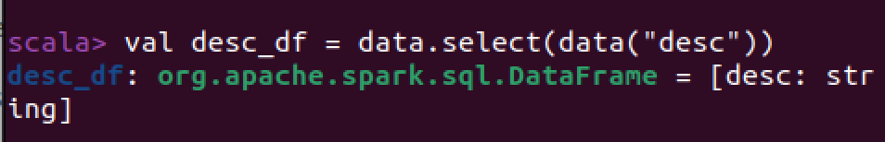
Project Content:Spark
After uploading the file, we enter spark-shell and read the file into dataframe type. Then we select a specific column of description for further processing.

Slide 12
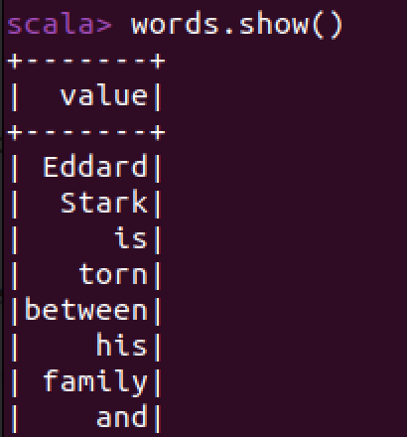
Project Content:Spark
We run the command
var words = desc_df.flatMap(_.getString(0).split(" ")).toDF()
to get single word in desc.

Slide 13
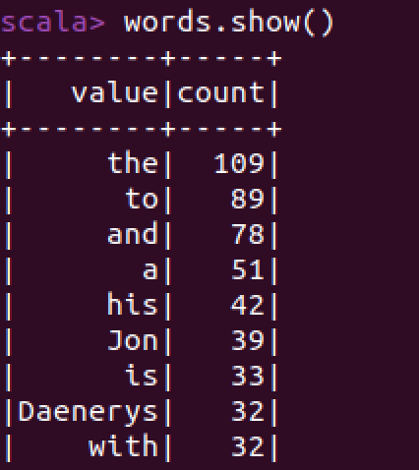
Project Content:Spark
To get the most used words, we use words = words.groupBy("value").count().orderBy($"count".desc)

Slide 14
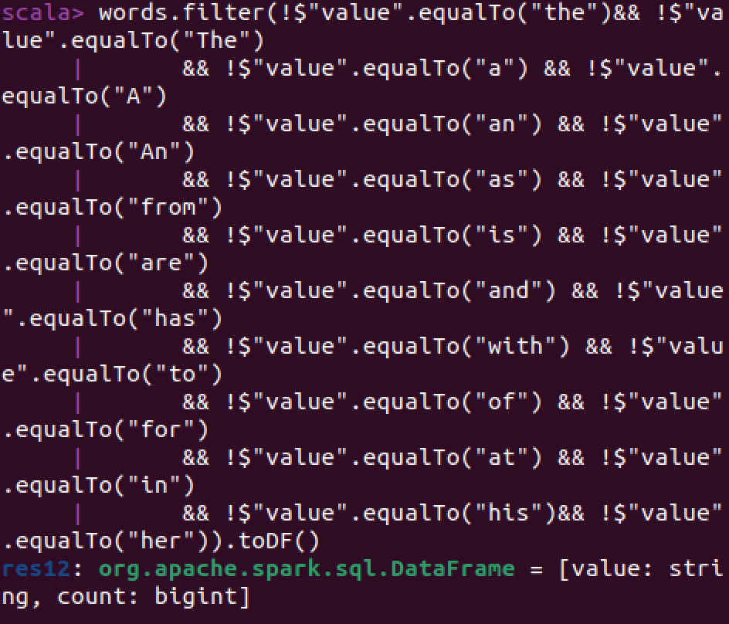
Project Content:Spark
However, there are some meaningless prepsitions and articles. So we delete them from the dataframe and saved to csv file by command
words.write.option(“header”,“true”).csv(“words.csv”).

Slide 15
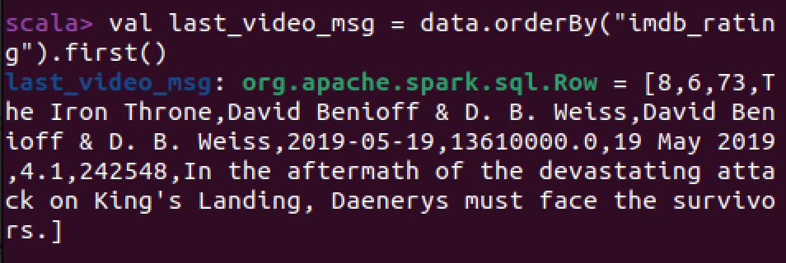
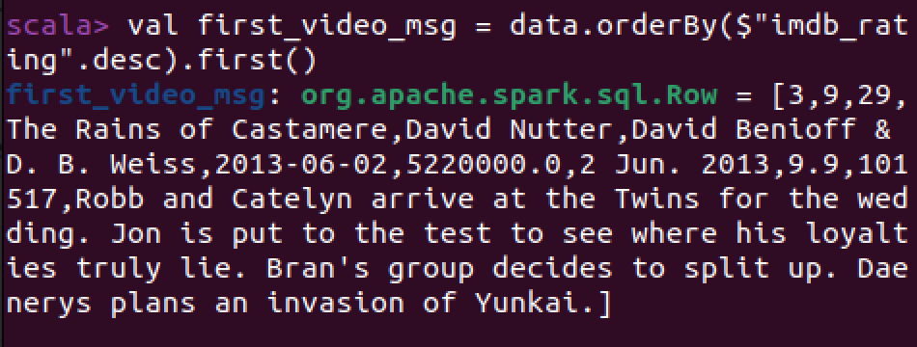
Project Content:Spark
We select the most liked and disliked show and their information based on their imdb_rating.

Slide 16
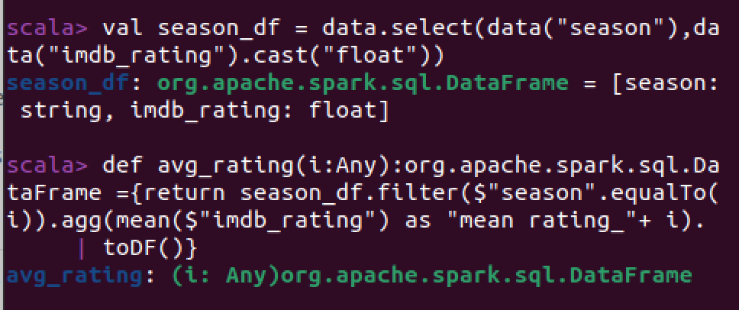
Project Content:Spark
We create a new dataframe to store season and imdb_rating information for calculating the average rating of each season.

Slide 17
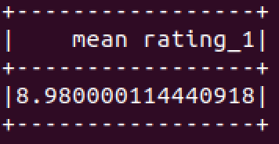
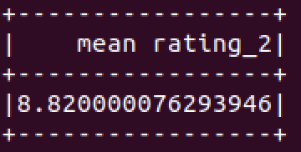
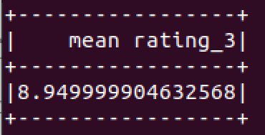
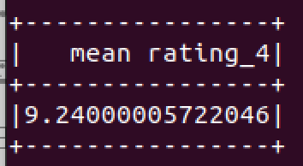
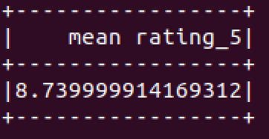
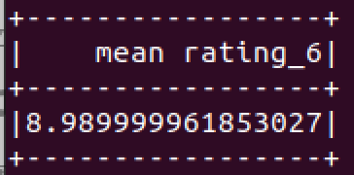
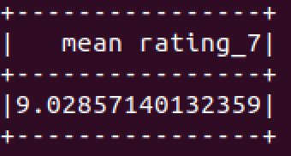
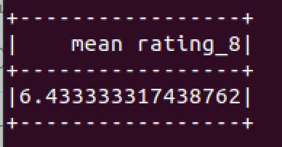
Project Content:Spark
We use a for loop to call the function we defined. The for loop is:
for(i <- 1 to 8) {avg_rating(i).show();}
After that, we generate a new season_df which contains two more columns us_viewers and total_votes and write to csv file.

Slide 18
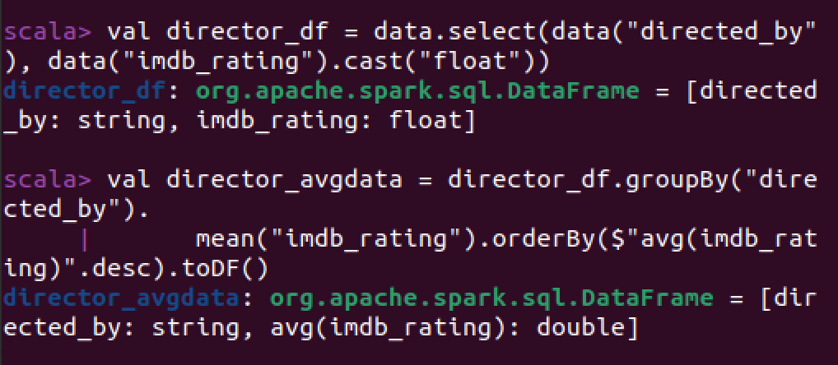
Project Content:Spark
We generate another csv file about directors and average ratings of TV shows directed by each of them.

Slide 19
03
Visualization
A clearer way

Slide 20
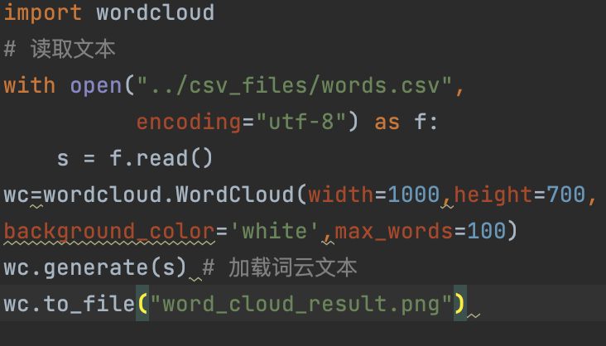
Visualization: word cloud
In this project, we use python for visualization part.
We load the words.csv file which contains separated word of descriptions.
We then generate word cloud for that file.

Slide 21
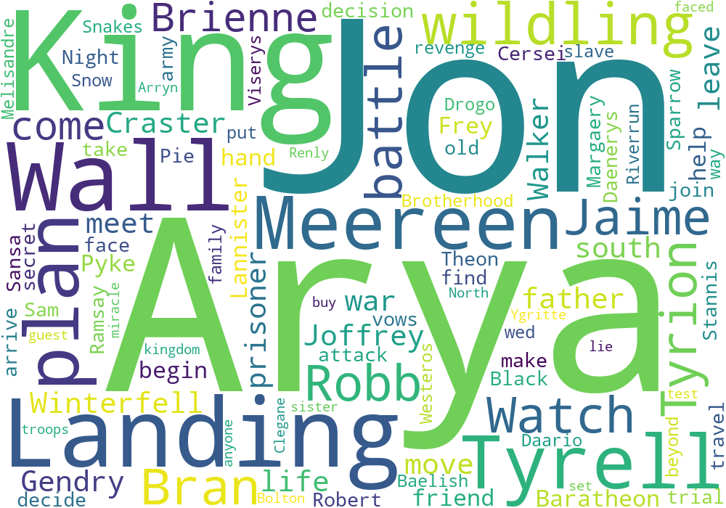
Visualization: word cloud

Slide 22
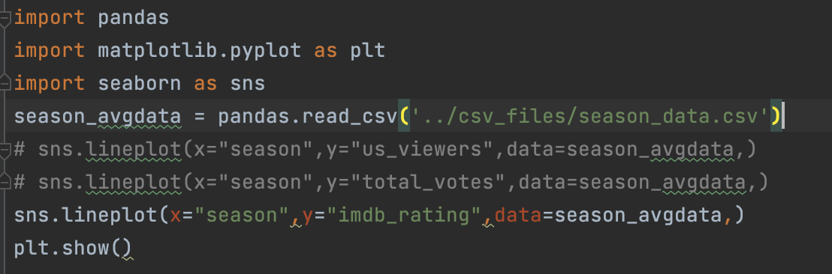
Visualization: seaborn
For season data generated from spark, we plot three graphs to show the rating, viewers in US and total votes difference of each season.

Slide 23
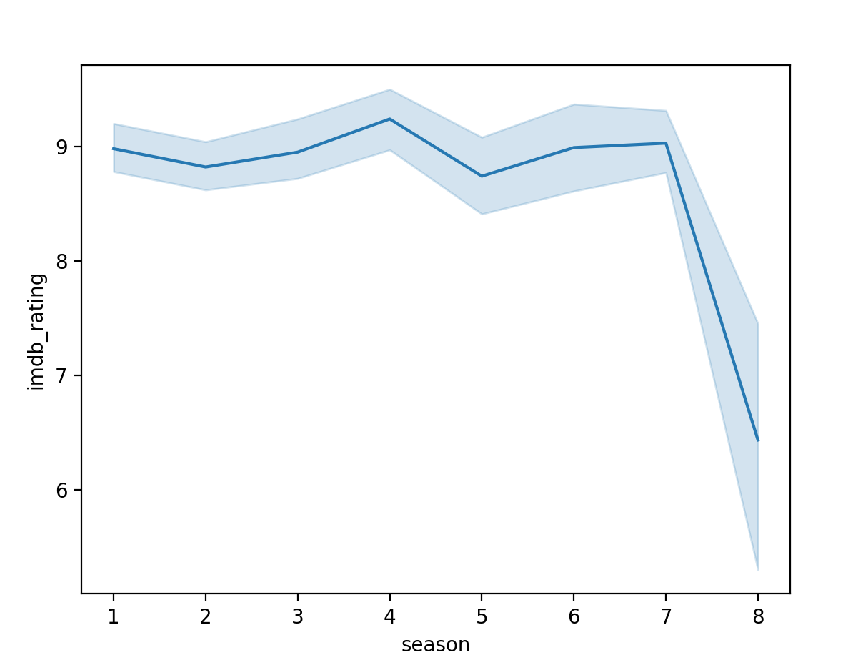
Visualization: seaborn
From the graph we can see that rating suffers a sharp decline in season 8.
This is the same with the avg_rating generated in spark. This result directly indicates that the TV drama had a terrible ending

Slide 24
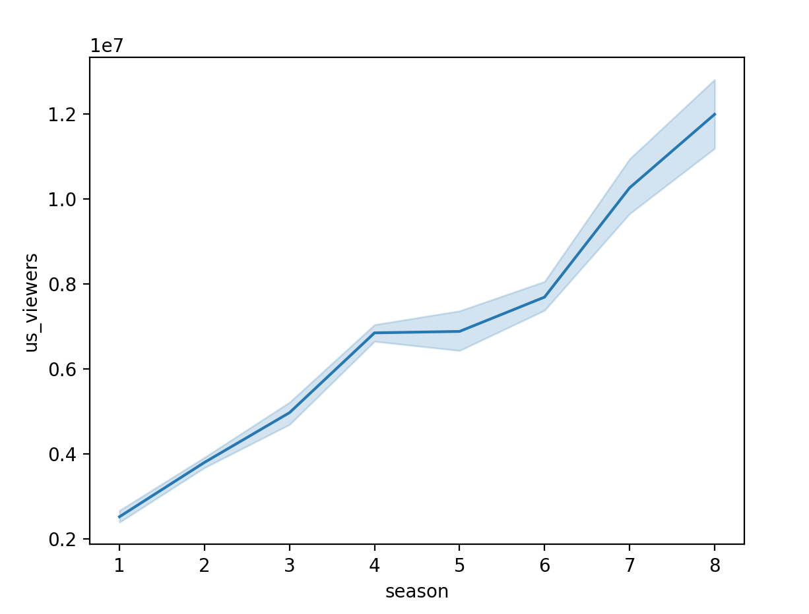
Visualization:seaborn
From the graph we can see that viewers in US continue to increase, which reflects the popularity of the show.

Slide 25
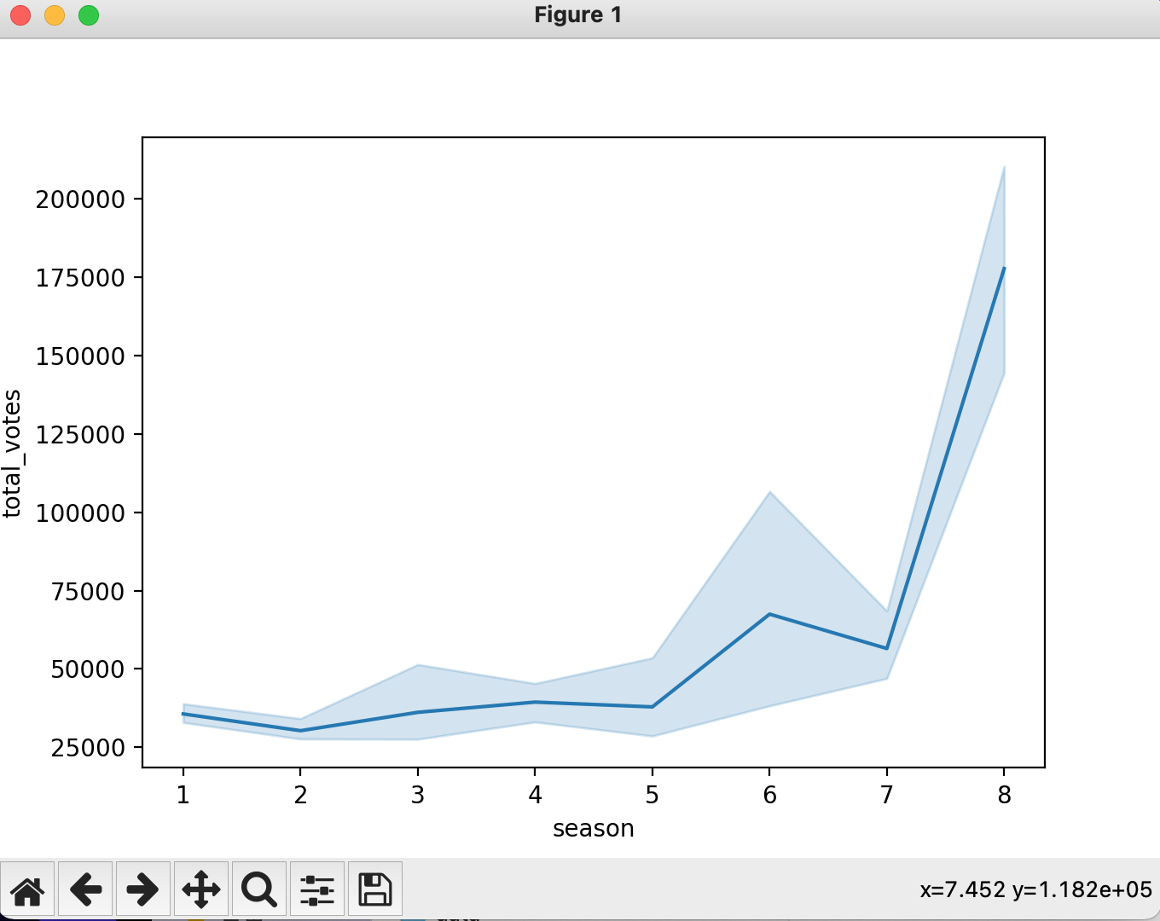
Visualization:seaborn
From the graph we can see that the trend of votes’ increase is almost the same with the viewers’.

Slide 26
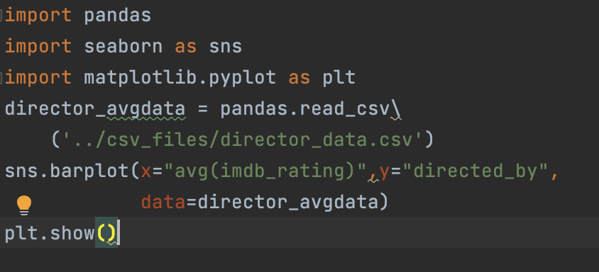
Visualization:seaborn
We read from the director data and generate a bar graph about the relationship of director and ratings of their shows.

Slide 27
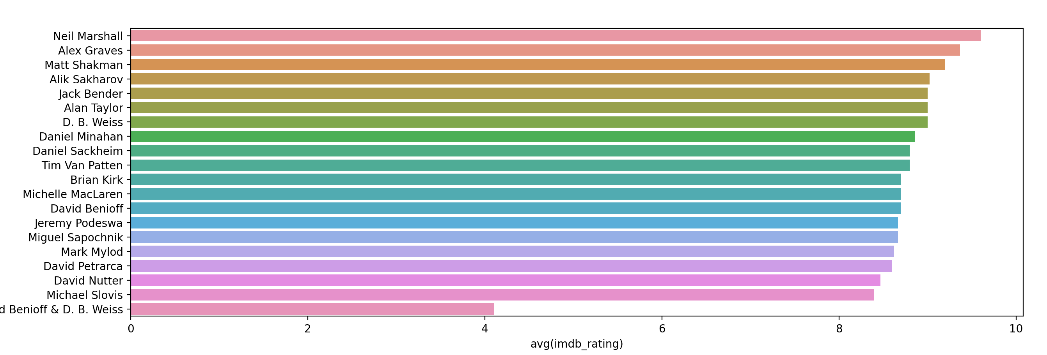
Visualization: seaborn
It can be seen that the average score of David Benioff & D.B.Weiss is the lowest among them, while the scores of other directors are almost the same.

Slide 28
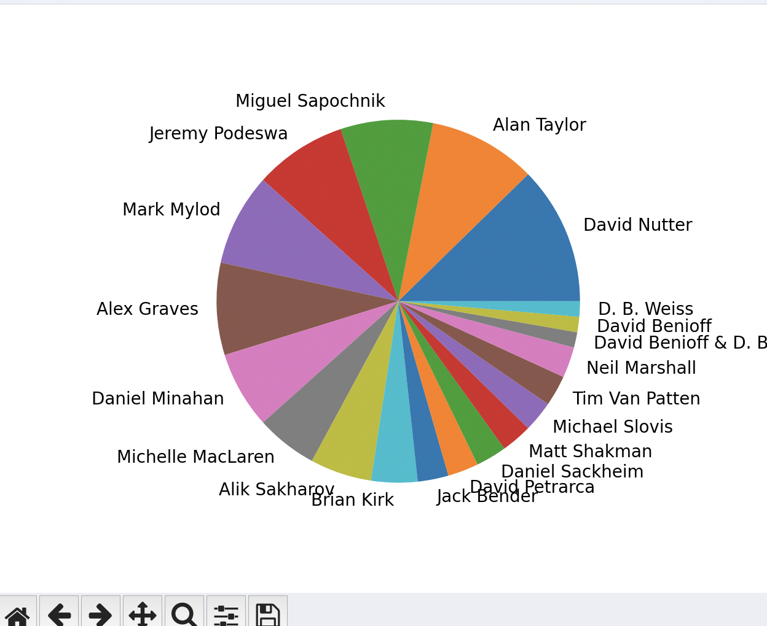
Visualization: seaborn
Take a look at the proportion of episodes directed by each director. The directed_by column in the data table is grouped and aggregated using count()
We can see that the director who directed the most is David Nutter.

Slide 29
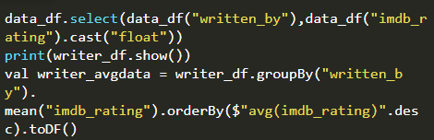
Visualization: seaborn
Then we analyze the relationship between different authors and ratings. Similar to the analysis of the relationship between different directors and ratings, the two columns written_by and imdb_rating are first selected, and then grouped and aggregated according to the written_by column to calculate the average imdb_rating. In this way, the average scores of writers of different episodes are obtained.

Slide 30
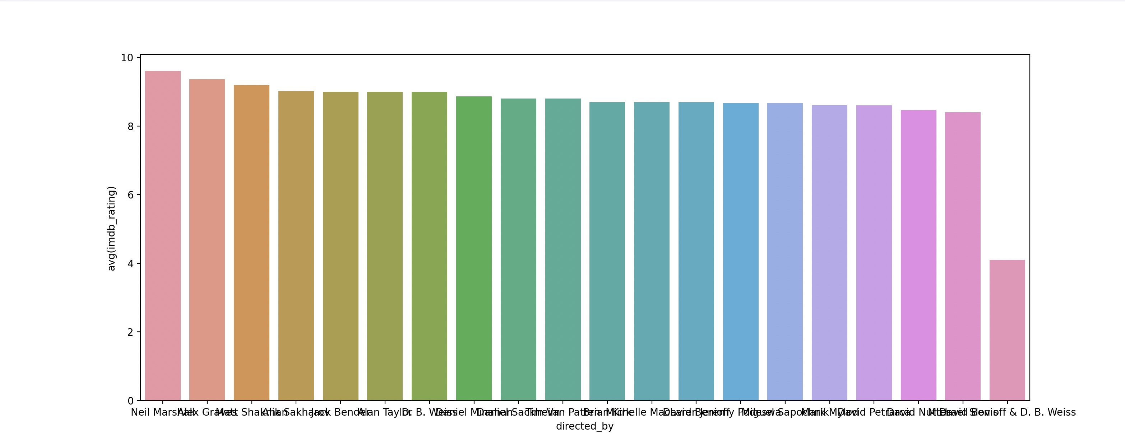
Visualization: seaborn
As you can see, there is no problem with the script itself, and the scores for each author's series are about the same (the highest score, as you can see, goes to George R.R. Martin).

Slide 31
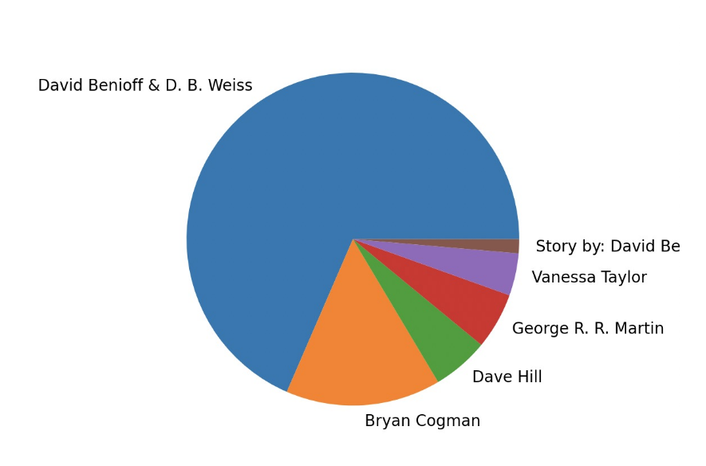
Visualization: seaborn
Finally, we take a look at the percentage of the play does each writer write
Most of the episodes are written by David Benioff&D.BWeiss, who are also the show's executive writers.

Slide 32
04
Conclusion
What we get

Slide 33
Conclusion
From the result we can know that in general Game of Thrones is a high-quality TV series. The number of viewers grows every season and the rating of the first 7 seasons are relatively high. However, the final season is not satisfying. Maybe other directors can learn from this experience and produce better TV series.

Slide 34
Thanks
汇报人：贾博凯 何宏栋 李明锐
王博瑛 陈致宁
导 师：张美慧

